Slide 1
Daily Review
Food Chains
Producers make their own food.
Consumers are labelled according to their order in the chain: primary, secondary or tertiary consumer.
Decomposers break down dead material and are usually bacteria or fungi.
Draw a food chain on your whiteboard that has a producer, three consumers and a decomposer. Label each organism with its position.
Don’t erase your food chain.

Slide 2
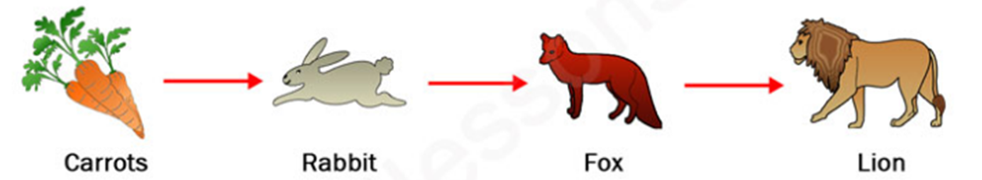
Daily Review
Trophic Levels
In a food chain, the third trophic level is the secondary consumers.
In your food chain, label each organism with its trophic level.
Don’t erase your food chain.
Trophic Level
1
2
3
4

Slide 3
Daily Review
Ecological Pyramids
Food chains can be represented as ecological pyramids.
The first trophic level goes at the base of the pyramid.
The second trophic level goes on the second level of the pyramid.
And so on, until the last organism in the chain is placed at the top of the pyramid.
Redraw your food chain as an ecological pyramid.
Trophic Level
1
2
3
4

Slide 4
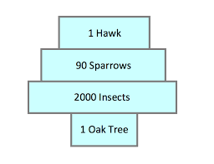
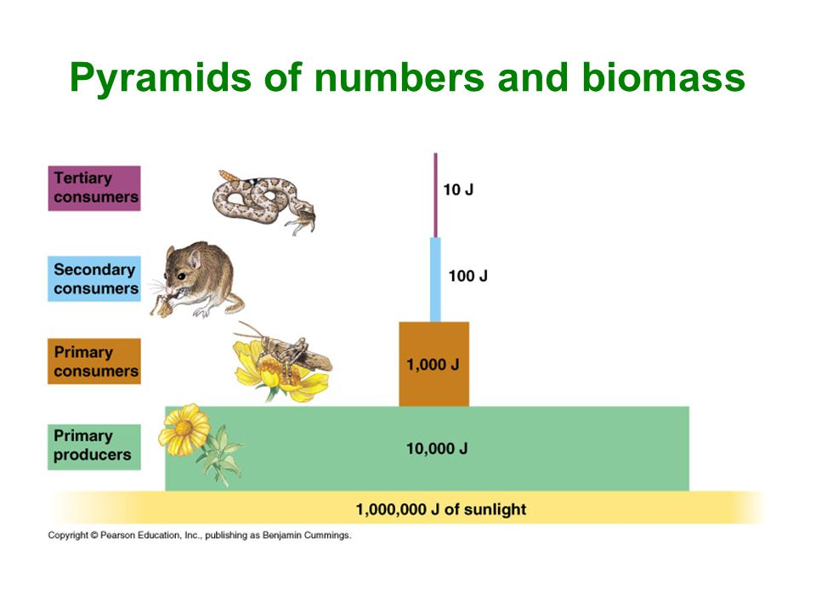
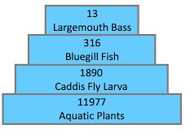
Daily Review
1
Types of Ecological Pyramids
Upright pyramid of numbers shows how many organisms are at each trophic level and has many producer organisms.
Inverted pyramid of numbers also shows how many organisms are at each trophic level, but has one producer organism.
Pyramid of energy shows how much energy is available at each trophic level.
Match each pyramid with its name.
2
3

Slide 5
Relationships Between Organisms

Slide 6
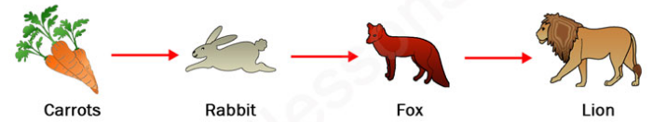
Learning Objectives
CFU
What are we going to learn?
Review and identify types of symbiosis
Describe different relationships between organisms.
Activate Prior Knowledge
The picture shows a food chain.
In the food chain:
Which organisms would be classed as predators?
Which animal does the fox prey on?
Think, pair, share: Why is the rabbit not classed as a predator?

Slide 7
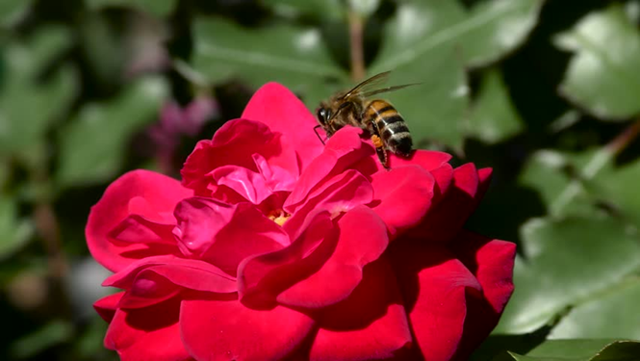
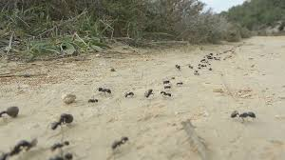
Concept Development
CFU 1
What does the type of relationship depend on?
CFU 2
The rose and the bee are different species. Think, pair, share: Describe how they interact with each other.
Relationships Between Organisms
The type of relationship between organisms depends on how the organisms interact.
Relationships between organisms can be short term or long term.
There are relationships between different species or within the same species.
CFU 3
The ants are the same species. Think, pair, share: Describe how they are interacting with each other.
CFU 4
Think, pair, share: Are these relationship short-term or long-term? Explain your choice

Slide 8
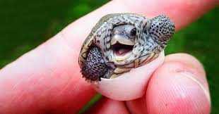
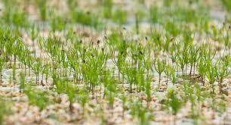
Concept Development
CFU 1
Think, pair, share: How are collaboration and mating similar?
Relationships Within the Same Species
Collaboration is when organisms co-operate with each other to ensure their survival.
Ants leave a scent trail so other ants can find food.
Mating produces new offspring so the species can survive.
Competition occurs when organisms are fighting for the same limited resources.
Seedlings in a forest compete for light and space.
CFU 2
Think, pair, share: How is competition different to collaboration and mating?
CFU 3
Think, pair, share: What is another example of collaboration in the animal kingdom?
CFU 4
Think, pair, share: What is another example of competition between organisms?

Slide 9
Concept Development
Relationships Within the Same Species
Watch the short video about bottlenose dolphins.
While you are watching, identify the types of relationships between the dolphins (collaboration, mating or competition)

Slide 10
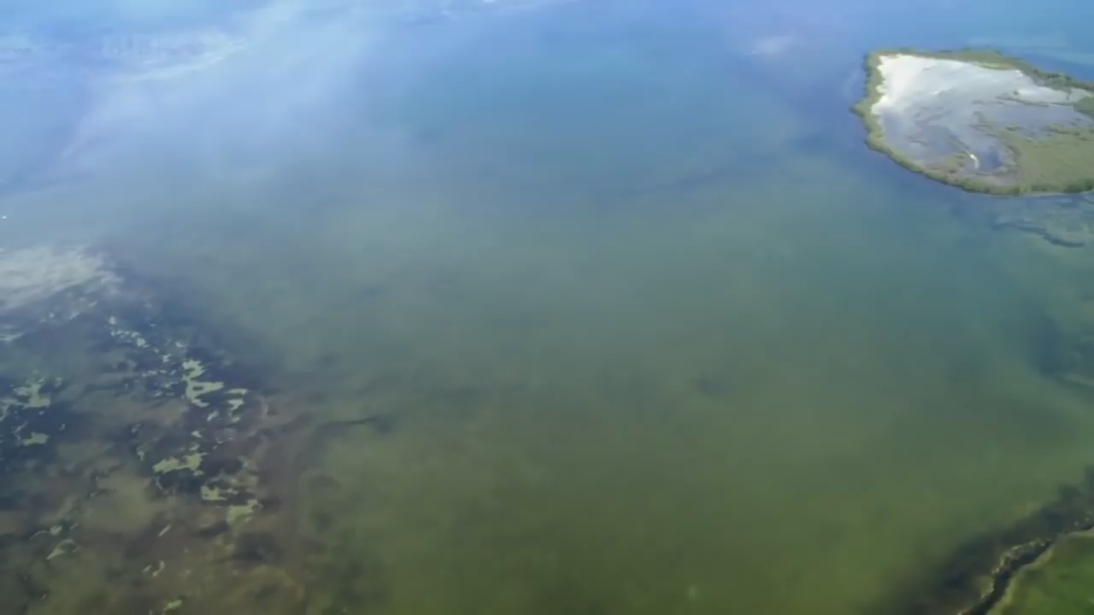

Slide 11
Concept Development
Relationships Within the Same Species
Watch the short video about bottlenose dolphins.
While you are watching, identify the types of relationships between the dolphins (collaboration, mating or competition)
Which types of relationships were you able to see?

Slide 12
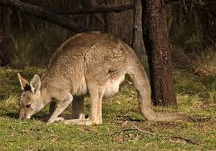
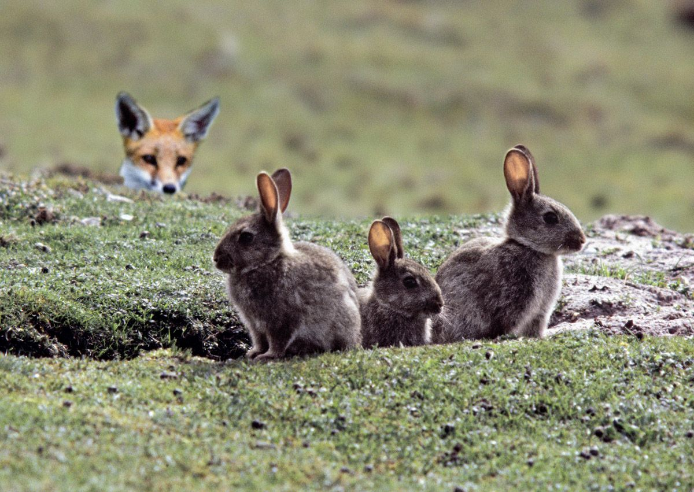
Concept Development
CFU 1
Think, pair, share: What is another example of competition between different species?
Short-term Relationships Between Different Species
Competition also occurs between different species that are fighting for the same limited resources.
Rabbits and kangaroos compete for food sources.
A predator – prey relationship exists between organisms of different species, when one organism is hunted as a food source for the other.
Foxes (predator) hunt rabbits (prey) for food.
CFU 2
Think, pair, share: What is another example of a predator-prey relationship?
CFU 3
Would a rabbit eating grass be considered a predator-prey relationship? Explain your choice.

Slide 13
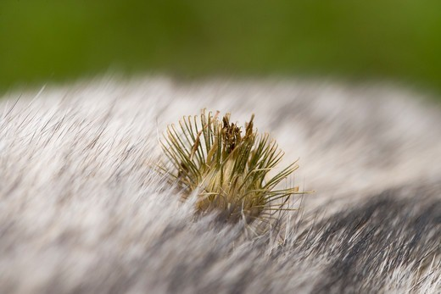
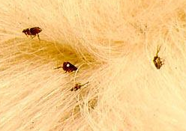
Concept Development
CFU 1
A leech feeds off a human. What type of relationship is this? Explain your choice.
Long-term Relationships Between Different Species (Symbiosis)
Mutualism is when both species benefit.
Bees pollinate flowers and the flower provides food for them.
Commensalism is when one species benefits and the other is unaffected.
Some plant seeds have hooks, which catch on an animal’s fur and help spread the seeds.
Parasitism is when one organism (parasite) lives in or on the body of another organism (host). The parasite benefits and the host is harmed.
Fleas living on dogs are parasites.
CFU 2
Think, pair, share: What is another example of commensalism?
CFU 3
What is the difference between mutualism and commensalism?

Slide 14
Skill Development/Guided Practice
Relationships Between Organisms
Describing Relationships
Use the flow chart to identify the relationship Use the words in the flow chart to describe the relationship
Same Species
Different Species
Helping the species survive
Fighting for resources
Short term
Long term
Working together
Producing offspring
One hunting another
Both benefit
One benefits
One is harmed
A rose provides food for bees, which pollinate the rose. Describe the relationship between a rose and a bee.
Collaboration
Competition
Mutualism
Parasitic
Mating
Predator-Prey
Commensalism
This relationship is mutualism. It is a long term relationship between different species where they both benefit.

Slide 15
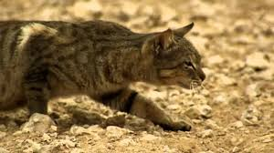
Skill Development/Guided Practice
Relationships Between Organisms
Describing Relationships
Use the flow chart to identify the relationship Use the words in the flow chart to describe the relationship
Same Species
Different Species
Helping the species survive
Fighting for resources
Short term
Long term
Working together
Producing offspring
One hunting another
Both benefit
One benefits
One is harmed
A feral cat hunts small native birds. Describe the relationship between a feral cat and a native bird.
Collaboration
Competition
Mutualism
Parasitic
Mating
Predator-Prey
Commensalism
This is a predator-prey relationship. It is a short term relationship between different species where one is hunting the other for food.

Slide 16
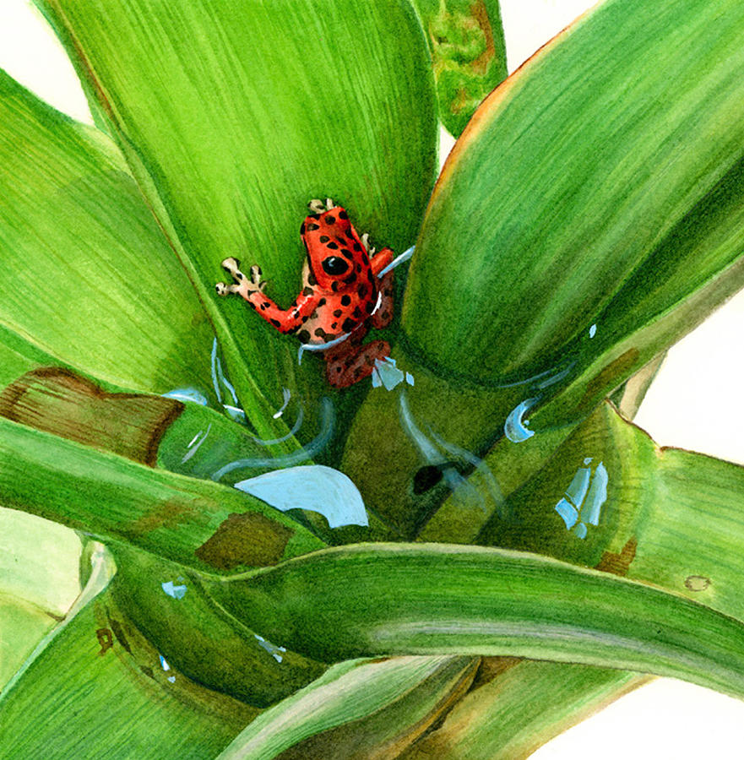
Skill Development/Guided Practice
Relationships Between Organisms
Describing Relationships
Use the flow chart to identify the relationship Use the words in the flow chart to describe the relationship
Same Species
Different Species
Helping the species survive
Fighting for resources
Short term
Long term
Working together
Producing offspring
One hunting another
Both benefit
One benefits
One is harmed
A poison arrow frog raises its tadpoles in water trapped in bromeliad plants. Describe this relationship.
Collaboration
Competition
Mutualism
Parasitic
Mating
Predator-Prey
Commensalism
This is an example of commensalism. It is a long term relationship between different species where one species benefits and the other is not affected.

Slide 17
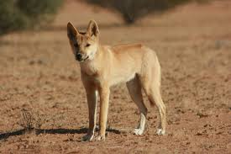
Skill Development/Guided Practice
Relationships Between Organisms
Describing Relationships
Use the flow chart to identify the relationship Use the words in the flow chart to describe the relationship
Same Species
Different Species
Helping the species survive
Fighting for resources
Short term
Long term
Working together
Producing offspring
One hunting another
Both benefit
One benefits
One is harmed
Dingoes and foxes both feed on rabbits. Describe the relationship between a dingo and a fox.
Collaboration
Competition
Mutualism
Parasitic
Mating
Predator-Prey
Commensalism
This is an example of competition. It is a short term relationship between different species where they are both fighting for the same resource.

Slide 18
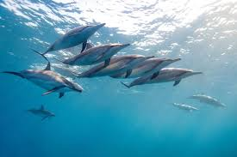
Skill Development/Guided Practice
Relationships Between Organisms
Describing Relationships
Use the flow chart to identify the relationship Use the words in the flow chart to describe the relationship
Same Species
Different Species
Helping the species survive
Fighting for resources
Short term
Long term
Working together
Producing offspring
One hunting another
Both benefit
One benefits
One is harmed
A pod of dolphins surrounds a school of fish. Describe the relationship between dolphins.
Collaboration
Competition
Mutualism
Parasitic
Mating
Predator-Prey
Commensalism
This relationship is collaboration. It is organisms of the same species working together to survive.

Slide 19
Relevance
Ecosystems are complex interactions between organisms and their surroundings.
Knowing about the types of relationships between organisms will help you understand how organisms interact in different ecosystems.

Slide 20
Skill Closure
When organisms of the same species work together, it is called collaboration. Give an example of collaboration between organisms.
Skill Closure
Competition occurs when organisms are competing for the same resources. Give an example of competition between different species.

Slide 21
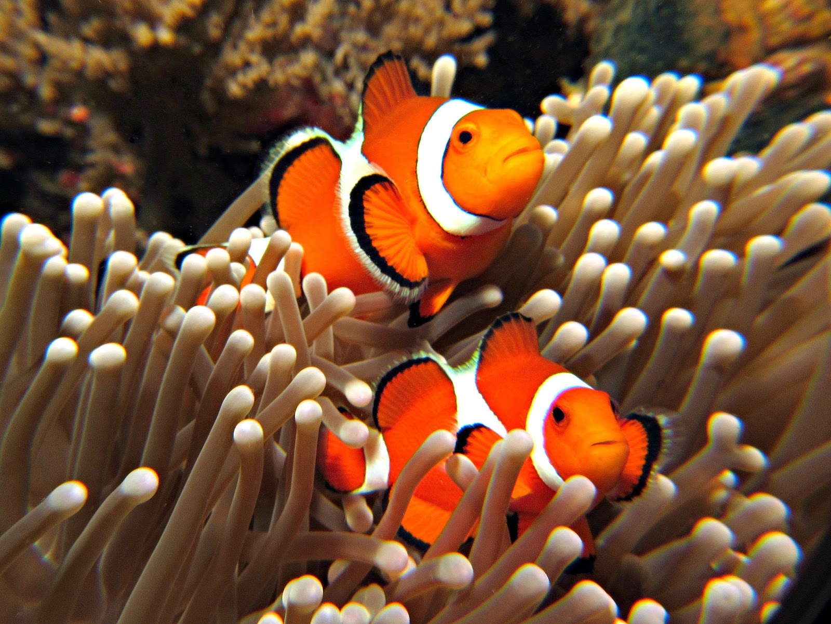
Skill Closure
Relationships Between Organisms
Use the flow chart to identify and describe the relationship below.
Clownfish hide in sea anemones. The clownfish are protected from predators by the anemone. Algae growing on the sea anemone is cleaned by the clown fish.
Same Species
Different Species
Helping the species survive
Fighting for resources
Short term
Long term
Working together
Producing offspring
One hunting another
Both benefit
One benefits
One is harmed
Collaboration
Competition
Mutualism
Parasitic
Mating
Predator-Prey
Commensalism

Slide 22
Independent Practice
Complete the worksheet on Relationships Between Organisms on your device or a paper copy.
Marigold
Rafflesia
Trumpet Vine
Cactus
Jasmine
Bottlebrush

Slide 23
Relationships Between Organisms
Same Species
Different Species
Helping the species survive
Fighting for resources
Short term
Long term
Working together
Producing offspring
One hunting another
Both benefit
One benefits
One is harmed
Collaboration
Competition
Mutualism
Parasitic
Mating
Predator-Prey
Commensalism

